Slide 1
Statistical Analysis of U.S. Border Inbound Crossings Data
IE 6200 Engineering Probability & Statistics
Group Number : 13
Group Members : Namrata Bhartiya, Jay Soman, Malavika Krishnan

Slide 2
Introduction
The US-Mexico border is one of the most restricted borders in the world, with 50 spots where one can legally cross the land.
Similarly, US-Canada border has 100 such points along the border , that permits legal entry into the country
The border crossing ports are ports of entry for land modes along the US-Canada and US-Mexico borders and the Bureau of Transportation Statistics (BTS) is responsible for maintaining the summary statistics for these inbound crossings.
The BTS was created in 1992.
BTS analyzes, compiles, collects information on intermodal transportations in all areas, and improves the quality and effectiveness of the DOT’s statistical programs through research, development of guidelines and promotion of improvements in data acquisitions and usage.

Slide 3
Objective
The data set consists of the incoming crossings at the US-Mexico and US-Canada borders and does not collect comparable data on the outbound crossings.
The data reflects the number of vehicles, containers, passengers or pedestrians entering the United States.
We intend to analyze the trends and meaningful statistical analysis on how the number of crossings through these borders using various means have changed over the past two decades.

Slide 4
Data Description
The dataset contains port level data about the inbound crossings into the United States from the two adjacent countries, namely Canada and Mexico from January 1996 to December 2020.
It comprises entries of passengers and different modes of transportation such as personal vehicles, trucks, buses, containers, trains.
The dataset contains the following variables:
1. Port Name: The port of entry into the US
2. State: The state in which the port is stationed
3. Port Code: Code to identify the port
4. Border: US-Canada Border and US-Mexico Border
5. Date: Date of entry into the United States(custom split into Month & Year)
6. Measure: Mode of transportation such as trucks, buses, rail, personal vehicles,etc
7. Value: Total count of inbound entries of a particular measure for a specific port

Slide 5
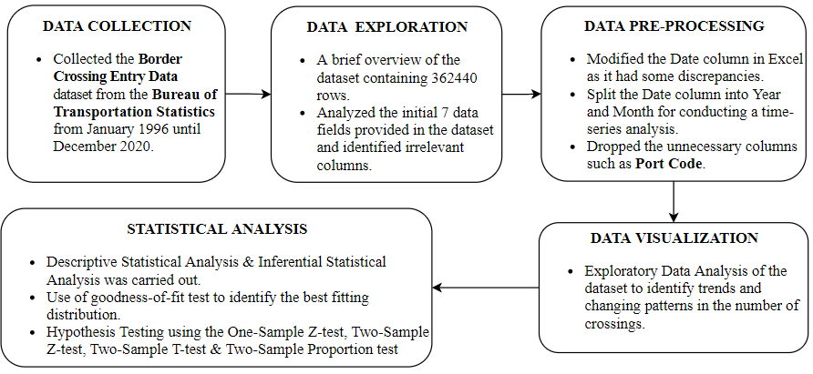
Data Processing
Fig.1. : Data Processing Steps performed on the Border Crossings Entry Dataset

Slide 6
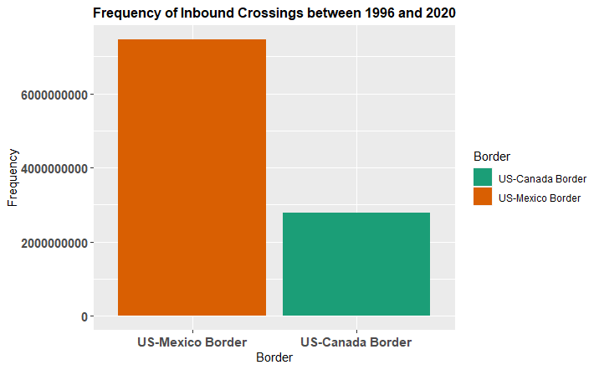
Descriptive Statistical Analysis
Fig.2. : Frequency of Inbound Crossings between 1996 & 2020
The US-Mexico Border has recorded around 7.5 Billion inbound crossings since January 1996, while the US- Canada Border has recorded around 2.8 Billion inbound crossings since January 1996, thereby indicating that the US-Mexico Border is approximately 2.5 times busier than the US-Canada Border.

Slide 7
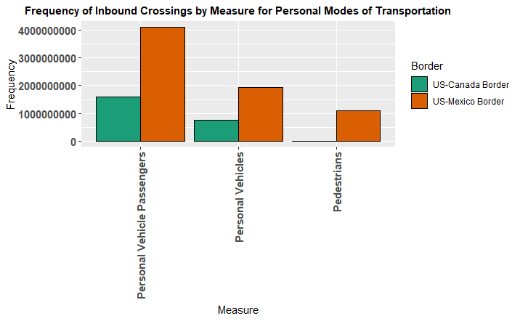
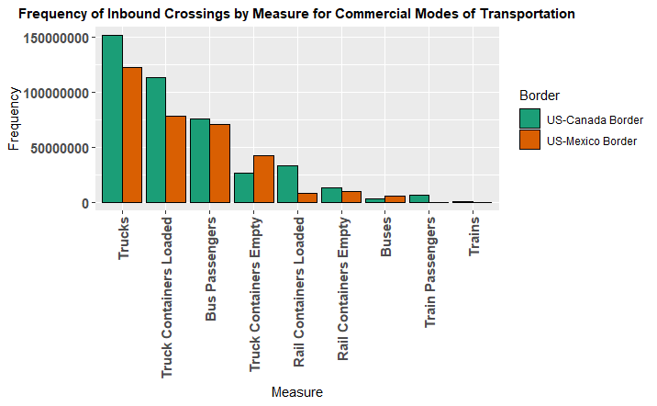
Descriptive Statistical Analysis
Fig.3. : Frequency of Inbound Crossings of Personal Modes of Transportation
Fig.4. : Frequency of Inbound Crossings of Commercial Vehicles
Passengers entering via Personal vehicles highest in number at US-Mexico Border(~4 billion).
US-Canada border barely has any significant pedestrian entries(~13 million) when compared to the US-Mexico border(~1 billion).
Trucks and loaded truck containers have the highest frequency followed by bus passengers at the US-Canada Border.
The number of inbound trains are the lowest at both borders; US-Mexico border recorded ~2.2 Lacs, while US-Canada border recorded ~7.4 Lacs train entries.

Slide 8
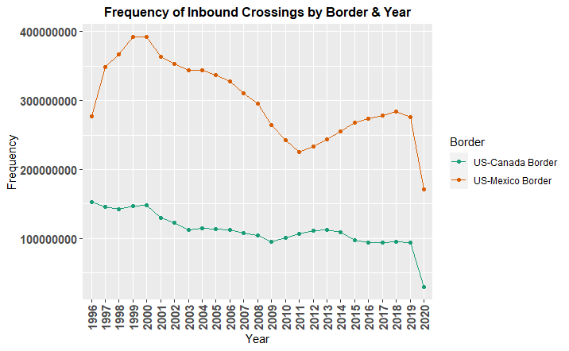
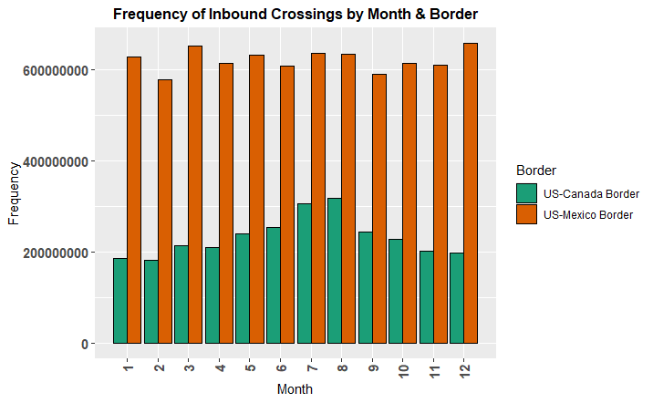
Descriptive Statistical Analysis - Continued
Fig.5. : Frequency of Inbound Crossing by Border and Year
Fig.6. : Frequency of Inbound Crossings by Border and Month
US-Canada had a steep decline from 2000 to 2010 and then a positive increasing trend until the pandemic year of 2020.
US-Mexico has been experiencing a constant declining trend from 2000 to 2019
US-Mexico border does not seem to have a seasonality trend whereas US-Canada crossings has a seasonal peak around July with a normal shaped curve
Notes:
personal vehicles travel>commercial vehicles

Slide 9
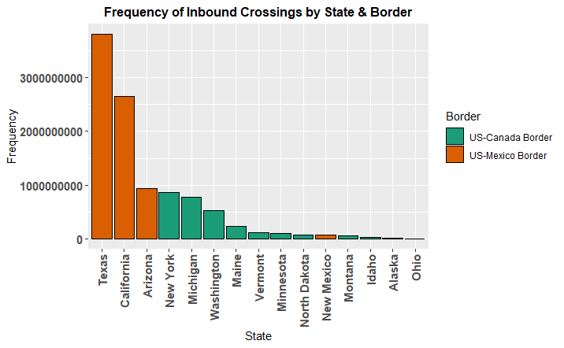
Descriptive Statistical Analysis - Continued
Bar plot of state wise border crossings
This backs up our earlier finding (Fig.1) that US-Mexico Border handles a lot more traffic than US-Canada
Texas handles the most inbound crossings
New York state handles the most inbound crossings from Canada
The graph is a right tailed (skewed) curve.
Fig.7. : Frequency of Inbound Crossings by State & Border

Slide 10
Inferential Statistical Analysis

Slide 11

Conditional Probability
Explored 2 Conditional Probability Questions
What is the probability that a truck entering the US will go to El Paso port given that it is crossing the US-Mexico border?
Answer = 6.3%
A = truck has entered visa the US-Mexico Border B = truck goes to El Paso
What is the probability that a person has entered the US for a non-business trip via the US-Canada Border, given that the person is a Pedestrian
Answer = 1.2%
A = a person has entered the US on a non-business trip(Bus, Pedestrian, etc.) B = a person is a Pedestrian amongst all non-business persons

Slide 12
Limitations of the Data
All variables (columns) are disjoint in nature
I.e. - a truck can enter the port of El Paso but cannot enter Tuscan AZ at the same time;
As data is only discrete, none of the continuous visualisations could be applied such as Cullen and Frey, QQ Plot and PP Plot
No data on what happens to the vehicle after it makes entry into port
I.e. - Does a truck finally end up in Los Angeles after making an entry at the port of El Paso?
No data on outbound crossings
Data needs geopolitical information to draw meaningful real world conclusions
I.e. - To explain the constant declining trend at the US-Mexico Border
Data is month wise, not day wise - Cannot visualize intra-month trends
Notes:
Regression - only had one numerical column; tried and couldn’t
Couldn’t use CUllen and frey graph, QQ plot and PPLot because its discrete data

Slide 13
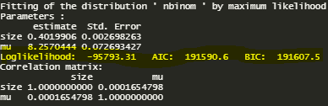
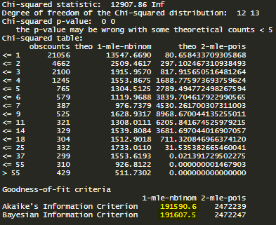

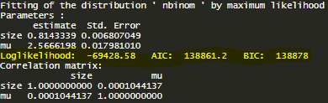
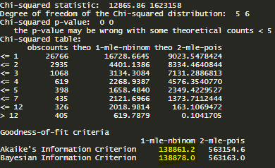

Goodness-of-fit test
Inbound Crossings at US-Canada Border
Fig.8.a. Fitting with Negative Binomial Distribution
The lower AIC and BIC values and higher Log Likelihood of Negative Binomial Distribution compared to Poisson Distribution indicate Negative Binomial Distribution is a better fit for our data than Poisson Distribution.
Fig. 8.b.Fitting with Poisson Distribution
Inbound Crossings at US-Mexico Border
Fig. 8.c. Goodness-of-Fit test
Fig.9.a. Fitting with Negative Binomial Distribution
Fig.9.b. Fitting with Poisson Distribution
Fig.9.c. Goodness-of-Fit test

Slide 14
Hypothesis Testing

Slide 15

One-Sample Z-test
Assuming the entire dataset is the population, we want to test if the mean value of inbound crossings of our sample data is equivalent to the population mean value of inbound crossings.
Population Mean (µ) = 28302.55
Sample : 1000 randomly selected observations from the Population
X ≡ R.V. of number of inbound crossings in the U.S.
Null Hypothesis -> There is no difference between the sample mean and population mean of inbound crossings
H0: µ = 19765
Alternate Hypothesis -> There is a significant difference between the sample mean and population mean of inbound crossings
H1: µ ≠ 19765
With 95% confidence, i.e., using a significance level of α = 0.05, the obtained P_value = 0.03679509 < 0.05. Thus, we reject the null hypothesis and conclude that there is a significant difference between the sample mean value of inbound crossings and population mean value of inbound crossings.

Slide 16

2. Two-Sample Z-test
Segregating the entire dataset into two different populations , we want to test if the mean value of inbound crossings of two different sets of samples taken from these two different populations is the same or not.
First Sample : Observations from rows 1 to 181220
Second Sample : Observations from rows 181221 to 362440
X1 ≡ R.V. of inbound crossings in the U.S. from first sample comprising 10000 randomly selected observations
X2 ≡ R.V. of inbound crossings in the U.S. from second sample comprising 10000 randomly selected observations
Null Hypothesis -> There is no difference between the mean of inbound crossings of the two samples selected
H0: µ1 − µ2 = 0
Alternate Hypothesis -> There is a significant difference between the mean of inbound crossings of the two samples
H1: µ1 − µ2 ≠ 0
With 95% confidence, i.e., using a significance level of α = 0.05, the obtained P_value = 0.000156468 < 0.05. Thus, we reject the null hypothesis and conclude that there is a significant difference between between the sample mean value of inbound crossings of the two samples.

Slide 17
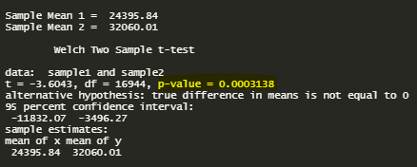
3. Two-Sample T-test
Testing the significance between means of two samples means if populations are independent and the variances are unknown, i.e., to test the equality of the mean value of inbound crossings of two random samples generated from the border crossing data.
First Sample : Observations from rows 1 to 181220
Second Sample : Observations from rows 181221 to 362440
X1 ≡ R.V. of inbound crossings in the U.S. from first sample comprising 10000 randomly selected observations
X2 ≡ R.V. of inbound crossings in the U.S. from second sample comprising 10000 randomly selected observations
Null Hypothesis -> There is no difference between the mean of inbound crossings of the two samples selected
H0: µ1 − µ2 = 0
Alternate Hypothesis ->There is a significant difference between the mean of inbound crossings of the two samples
H1: µ1 − µ2 ≠ 0
With 95% confidence, i.e., using a significance level of α = 0.05, the obtained P_value = 0.0003138 < 0.05. Thus, we reject the null hypothesis and conclude that there is a significant difference between the sample mean value of inbound crossings of the two samples. This is the same conclusion as that obtained using the two-sample Z-test.

Slide 18
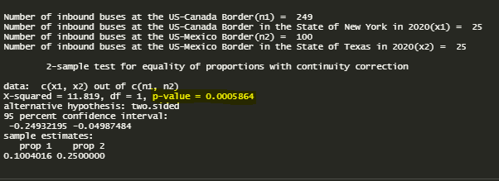
4. Two-Sample Proportion Test
Filtering out the dataset to test the equality of proportions of inbound bus crossings in the State of New York at the US-Canada Border & in the State of Texas at the US-Mexico Border in 2020.
X1 ≡ R.V. of number of inbound bus crossings at US-Canada Border
X2 ≡ R.V. of number of inbound bus crossings at US-Mexico Border
Null Hypothesis -> There is no significant difference between the proportions of inbound bus crossings in New York at US-Canada Border & in Texas at US-Mexico Border in 2020
H0: p1 − p2 = 0
Alternate Hypothesis -> There is a significant difference between the proportions of inbound bus crossings in New York at US-Canada Border & in Texas at US-Mexico Border in 2020
H1: p1 − p2 ≠ 0
With 95% confidence, i.e., using a significance level of α = 0.05, the obtained P_value = 0.0005864 < 0.05. Thus, we reject the null hypothesis and thus conclude there is a significant difference between the proportions of inbound bus crossings in New York at US-Canada Border & in Texas at US-Mexico Border in 2020.

Slide 19
Conclusion
From the studies, we observe that the US-Mexico border handles significantly more traffic than the US-Canada border.
It is observed that the most frequent measure to cross the border was trucks.
A trend can also be observed that there has been a steady decline in the number of crossings for the US-Canada border.
The results inferred from the analysis show that the most number of crossings occur at the borders of the state Texas, and California respectively.
Detailed statistical inferences have been drawn in the inferential statistics section and the report displays the unique characteristics of the two borders.

Slide 20
References
https://data.bts.gov/Research-and-Statistics/Border-Crossing-Entry-Data/keg4-3bc2

Slide 21
THANK YOU!

